Slide 1
Panimalar Engineering College
VOICE-ENABLED COMPLAINT SOLUTION
BATCH:C28
Prithika Srinithi.M
(2022PECCS246)
Priya.K(2022PECCS248)
Guide:Mrs.S.Sophana Jennifer.,M.E

Slide 2
ABSTRACT
In today's rapidly evolving market, consumer satisfaction is essential for business success. This paper introduces a Voice-Enabled Complaint Solution, designed to enhance the efficiency of conflict resolution by streamlining the process of lodging, managing, and resolving consumer complaints through an integrated digital platform. Key features of the VECS include automated ticket generation, real-time tracking, and comprehensive analytics to improve transparency and responsiveness. A notable aspect of the solution is its support for voice note submissions, enabling consumers to express their issues naturally and in greater detail. Furthermore, the system incorporates a feedback loop to continuously refine processes based on user experiences. This innovative approach not only boosts consumer trust and engagement but also equips businesses with actionable insights to enhance their products and services. The proposed VECS represents a significant advancement in customer service management, fostering a more responsive and customer-centric business environment.

Slide 3
EXISTING
Existing Voice-Enabled Complaint Solutions offer varied functionalities to enhance consumer complaint management. Notable examples include Google Dialogflow and Amazon Lex, which use natural language processing for voice interactions. Zendesk's Voice Integration adds voice support to its ticketing system, while IBM Watson Assistant provides customizable AI-driven solutions for complaint resolution. Microsoft Dynamics 365 integrates voice recognition for effective case management, and Nuance Communications focuses on secure, personalized voice interactions.
Platforms like Talkdesk enable real-time complaint management within existing frameworks, and customizable solutions such as VoiceFoundry cater to specific industry needs. These systems typically feature voice recognition, automated ticketing, multi-channel support, and analytics, addressing the complexities of modern complaint management while enhancing customer engagement.

Slide 4
PROPOSED
The proposed voice-enabled complaint solutions aims to revolutionize the handling of consumer complaints by integrating advanced features such as voice note submissions and rapid service status updates. By allowing consumers to submit voice notes, the system enhances the accuracy and richness of complaint descriptions, as these are transcribed into text for detailed processing. To maintain transparency and keep users informed, the VECS will provide real-time status updates through user-friendly dashboard for tracking complaint progress. Automated ticketing and prioritization will ensure that complaints are efficiently categorized and routed based on urgency, while integrated feedback mechanisms will gather consumer insights post-resolution to drive service improvements. The system will also feature comprehensive reporting and analytics to monitor performance metrics and identify trends, supporting data-driven decision-making. Additionally, the VECS will offer multi-channel integration, allowing complaints to be submitted through various platforms including web forms, mobile apps, and social media, ensuring accessibility and convenience. Built with a secure and scalable architecture, the system will protect sensitive data and accommodate a high volume of complaints, making it an essential tool for businesses striving to enhance their customer service and responsiveness.

Slide 5
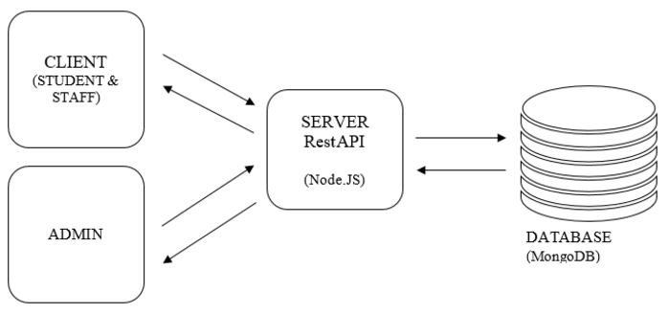

ARCHITECTURE DIAGRAM

Slide 6
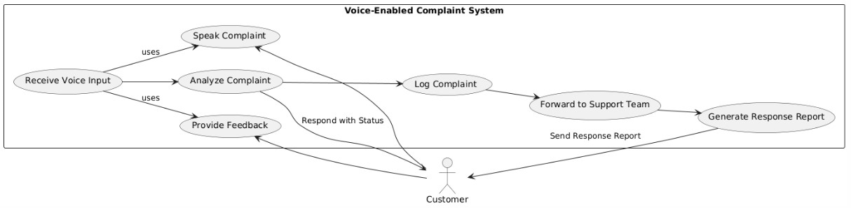
USECASE DIAGRAM

Slide 7
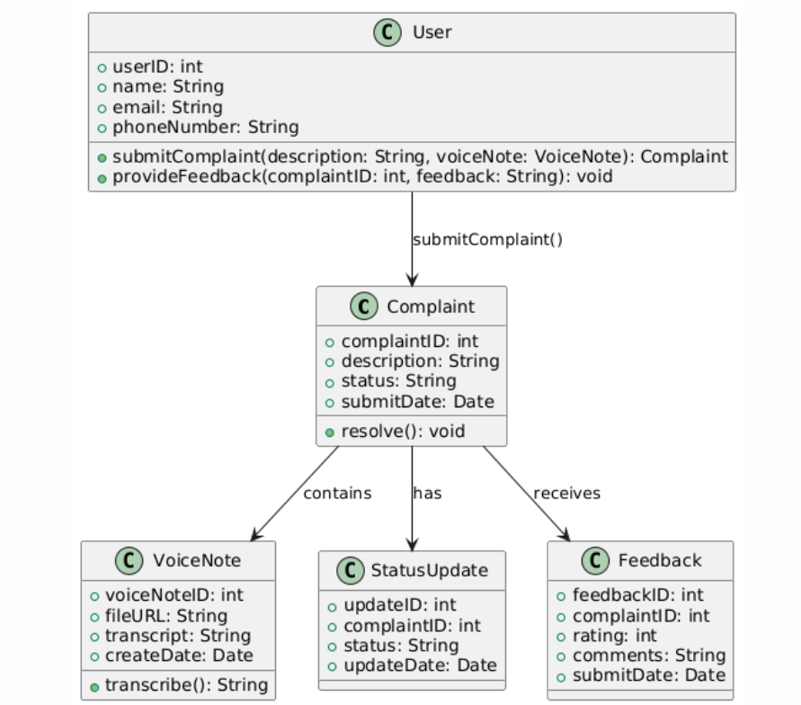
CLASS DIAGRAM

Slide 8
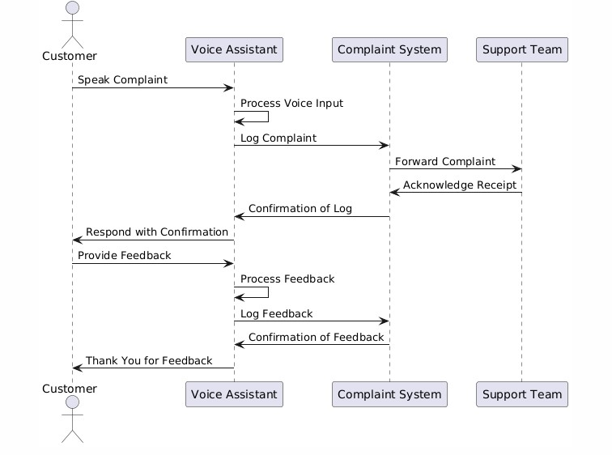
SEQUENCE DIAGRAM

Slide 9
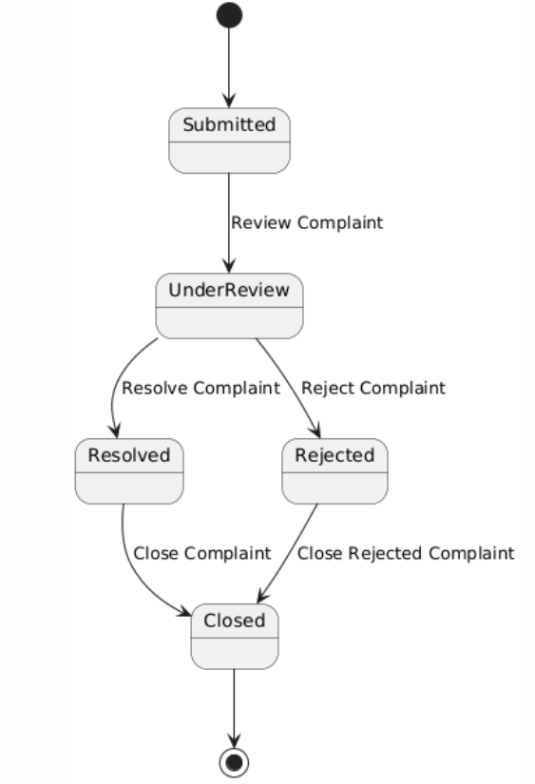
STATECHART DIAGRAM

Slide 10
Front-end Module
Back-end Module
login.html
loginServlet.java
registration.html
registerServlet.java
complaint.html

Slide 11
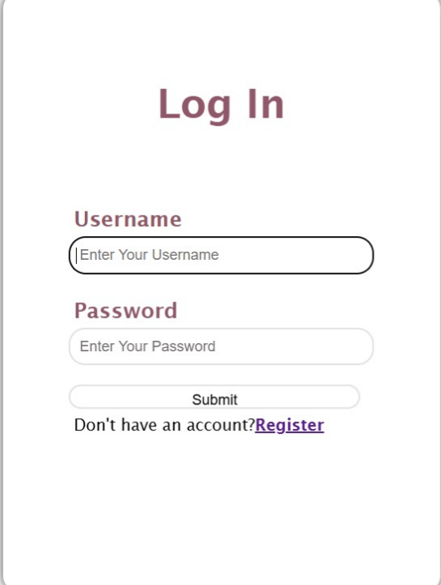
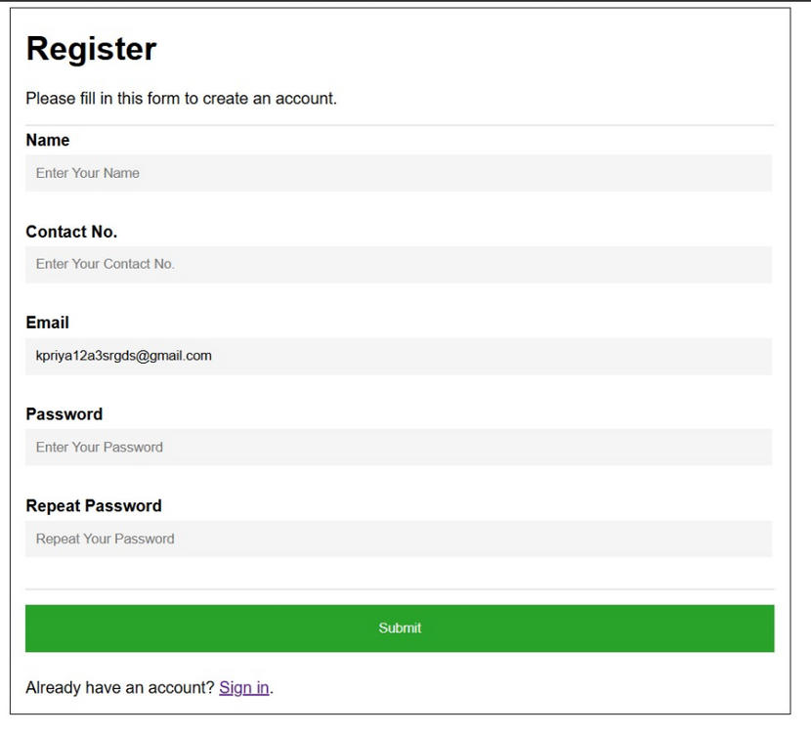
Output Screens
1.LOGIN PAGE
2.REGISTRATION PAGE

Slide 12
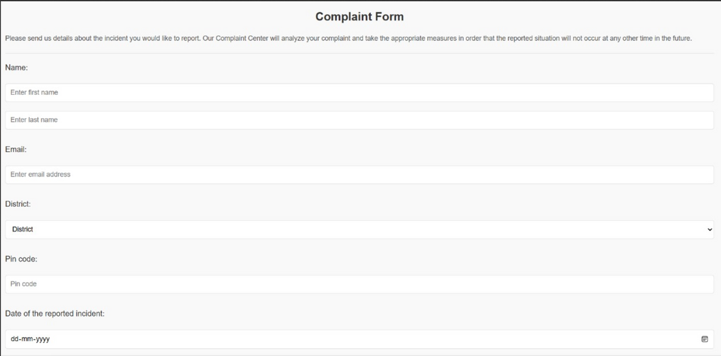
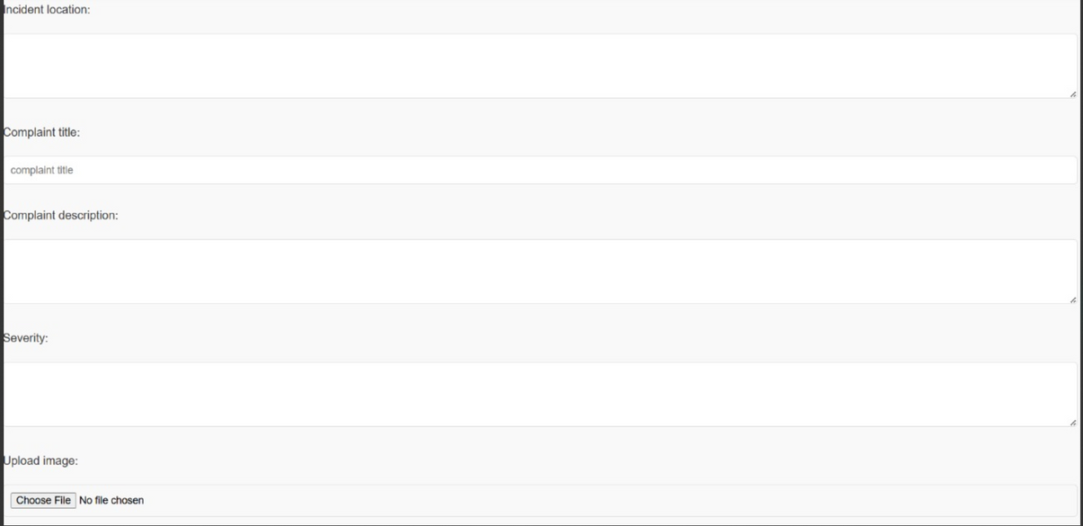

Slide 13
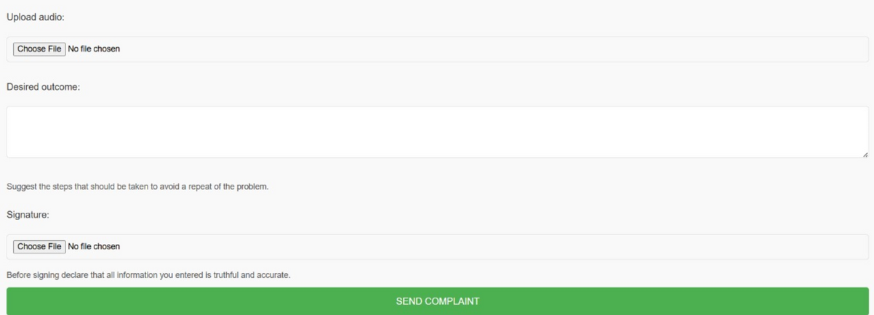
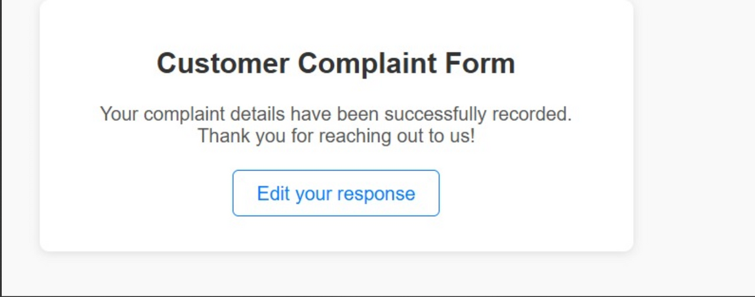
3.COMPLAINT PAGE
4.TICKET PAGE

Slide 14
FUTURE ENHACEMENTS
Advanced NLP: Better understanding of complex queries and emotions.
Multi-Language Support: Increased accessibility through multiple languages.
Sentiment Analysis: Gauging emotional tone to prioritize urgent issues.
Personalization: Tailored responses based on user history.
CRM Integration: Real-time updates and tracking within systems.
Voice Biometrics: Enhanced security through identity verification.
Proactive Management: Anticipating issues before they arise.
Omni-Channel Support: Seamless transitions between communication methods.
Feedback Loops: Continuous improvement based on user feedback.

Slide 15
THANK YOU

